Slide 1
Identifying Seattle Real Estate Redevelopment Targets
Ross Frischmuth

Slide 2
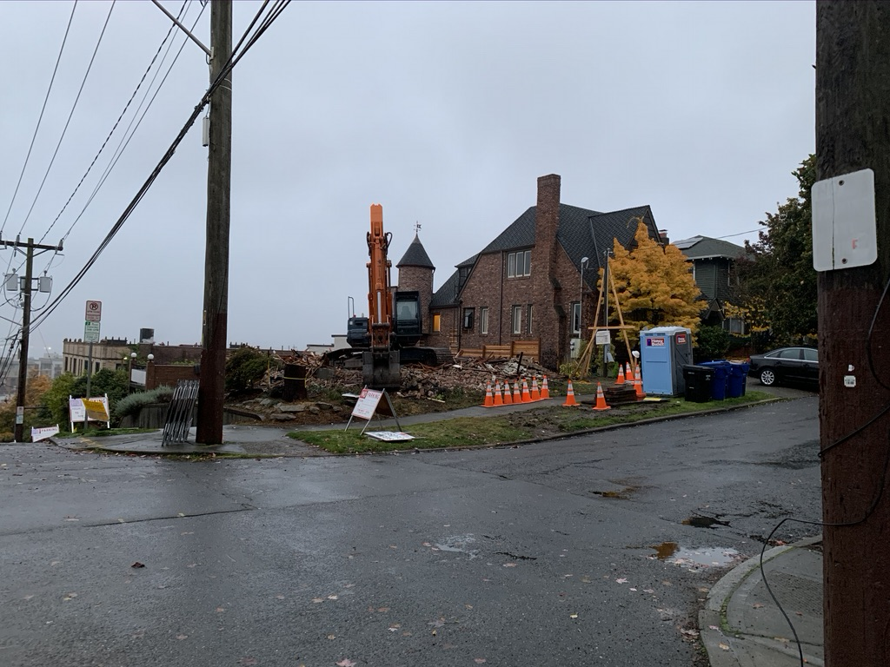
Problem Statement
Am I going to be living in a construction zone in the next few years?

Slide 3
Data Sources
King County Department of Assessments
Property value, zoning information, unit information
City of Seattle
Land use permits
King County GIS Center
Parcel Information

Slide 4
Methodology
Combine GIS and Parcel data into Spark DataFrame - X
PIN – Parcel Information Number as Index
Vectorize Features into single column
Numerical data remains numerical
Convert categorical data into separate indices
161,521 rows and 21,149 features
Filter city permitting data - y
Use only applied and approved permits

Slide 5
Model
K-Fold Splits
10 Folds
predict 10% of parcels at a time on 90% of training data
Repeat 10 times to get predictions on all parcels
Random Forest
Memory overload on local machine
Logistic Regression (first model did 70/30 train/test)
Score with area under curve of ROC (receiver operating characteristic) curve
AUC = .507 – Really bad

Slide 6
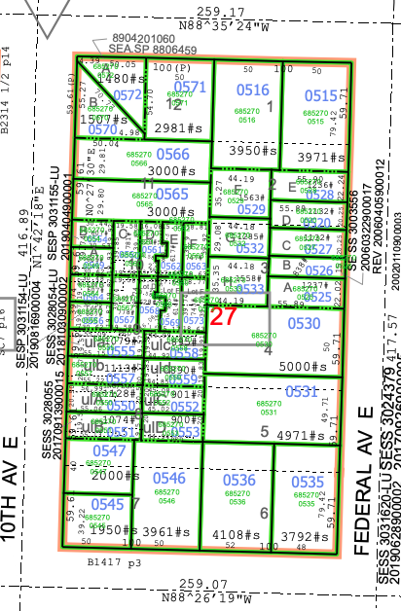
Deliverable
Display probability a specific parcel will redevelop
Assign value to property reflecting aggregate probability neighbors will redevelop

Slide 7
Questions?

